Slide 1
William Whitehead, Brian Raymond Period Detection using FFT and SFFT
Basic Principles
Convert to frequency domain since we are interested in frequency information
Use Fast Fourier Transform (FFT) or Sparse Fast Fourier Transform (SFFT)
Peaks in frequency domain represent harmonics of the period
How do we use all peaks to find a better result (instead of only using a single peak)

Slide 2
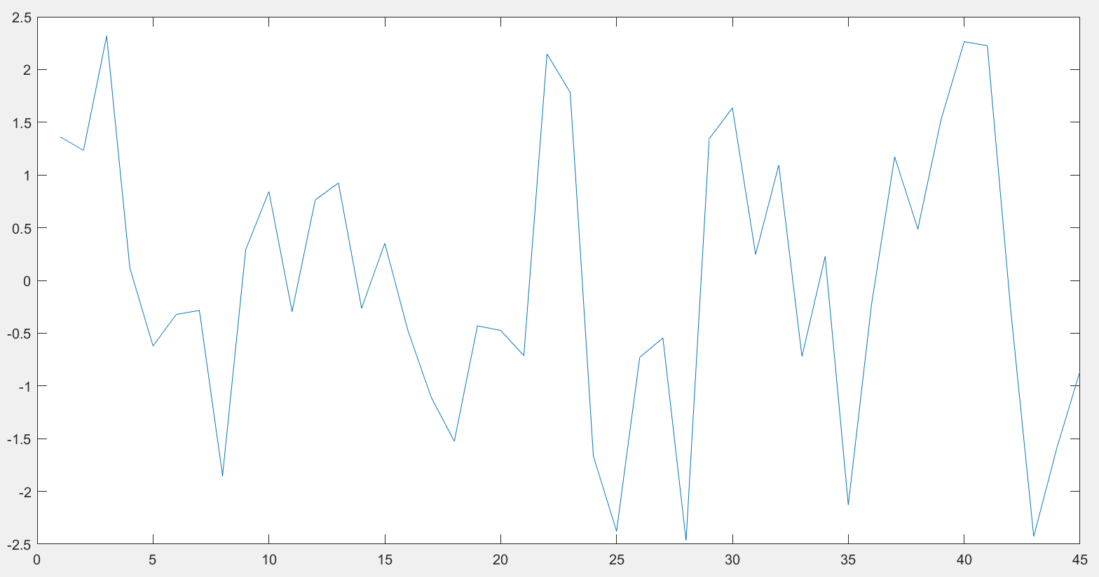
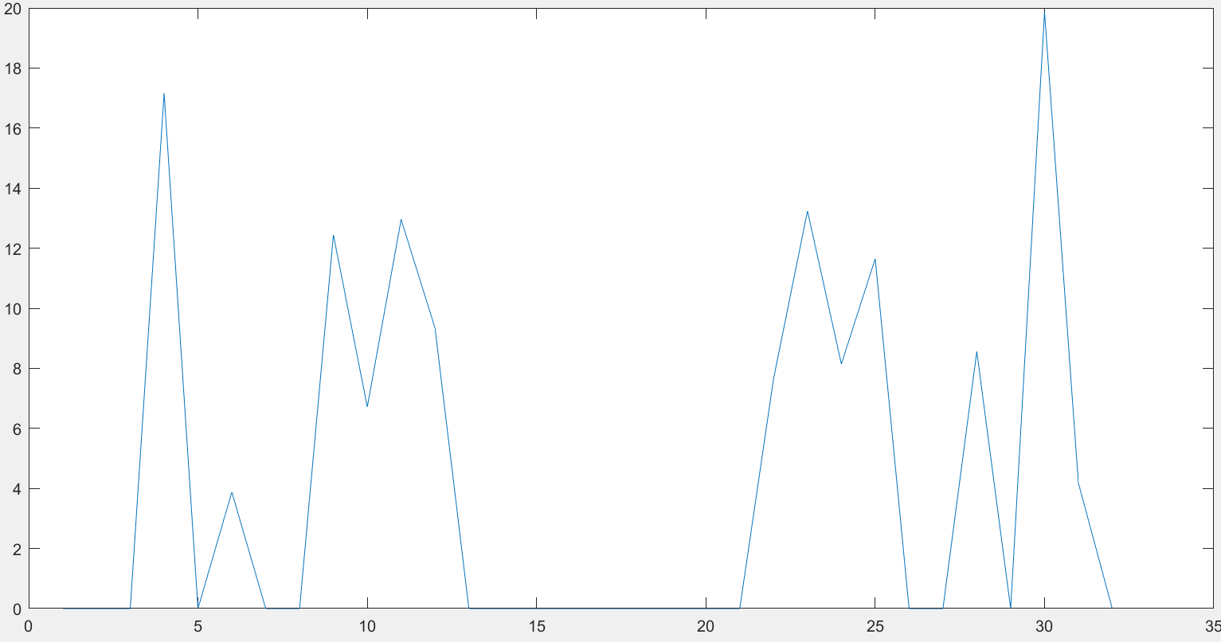
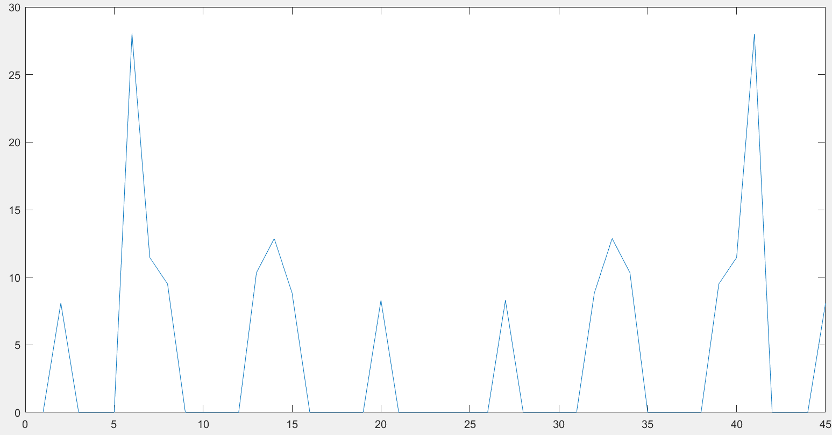
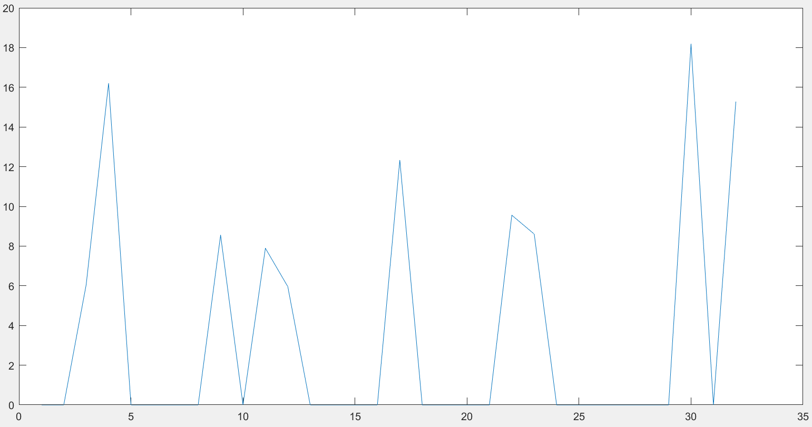
SFFT vs FFT Frequency Analysis
Time domain signal
SFFT Transform 1
FFT transform
SFFT Transform 2

Slide 3
Extracting Period from the Fourier Transform
Ideally, first major peak represents the fundamental frequency
Accuracy of the first peak – if the period repeats only a few times within the signal
First peak may only be a multiple of the fundamental frequency
Tried a method with successive approximation to incorporate data from subsequent peaks – did not work as planned

Slide 4
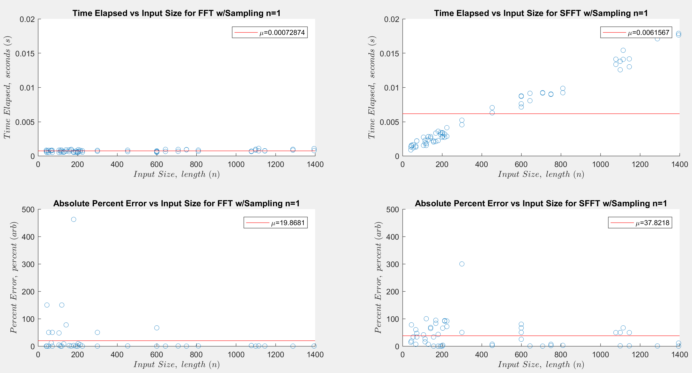
FFT vs SFFT Time and Accuracy Results

Slide 5
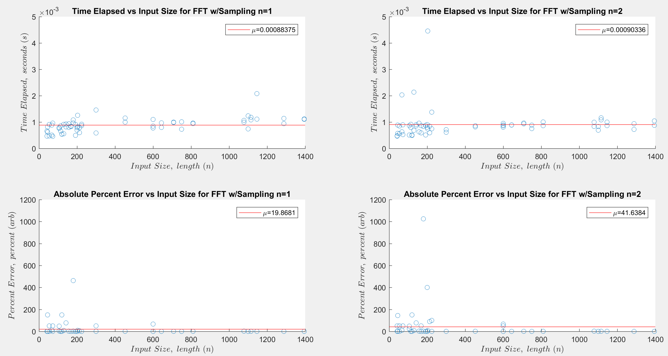
Sub-Sampling Results

Slide 6
Algorithm Time and Complexity Results
Experimentally, FFT is faster than SFFT. Two reasons:
Data size is relatively small
FFT implementation is optimized, compiled code while SFFT has significant portions in Matlab code
In theory, optimized SFFT would be faster:
Algorithm complexity with SFFT is O(n)
Algorithm complexity with FFT is O(n log(n) )

